Slide 1


JANNIVARAN
AI-Powered Citizen Grievance Redressal & Tracking System
RAMDEOBABA UNIVERSITY
Prasanna Dhote C-12 Kashish Sharma C-11 Taha Khan C-33
Rayan Sayeed C- 44 Vedant Garhewal C-47 Piyush Deshmukh C-49
Idea lab
COURSE CODE
Mentor Name - Prof. Sonam Meshram Department Of Computer Science And Engineering Academic Year - 2026 - 2027

Slide 2

2
PROBLEM STATEMENT
The Problem
U
Citizens often face difficulty in registering and tracking public complaints. Complaints may experience delays, poor visibility, or lack of follow-up. Citizens may not know:
Who is handling the complaint
What its current statusis
Who is Affected?
Citizen!s
Administrative authorities
i
Why is it Important?
Atransparent grievanceworkflow can improve complaint visibility, response monitoring, and accountability.
The JANIVARAN specifically focuses on preventing lost complaints and delayed resolutions through routing, SLA tracking, notifications, and escalation
02 September 2026
Slide 2 of 10

Slide 3
EXISTING SOLUTION / LITERATURE REVIEW
Existing Solutions
Traditionalcomplaintregistration through:
Helpl1ines
Email
Department-specific portals
EXISTING SOLUTIONS
LIMITATIONS
Limitations
Limited visibility into the complete complaint lifecycle
2
Manual follow-up may still be required
Citizen assistance during complaint submission may be limited
Research / Market Gap
Needfora unified platformthat combines:
Complaint Filing→ Department Handling → SLA Monitoring → Escalation → Notifications → Resolution Feedback
3
Proposed Approach
JANIVARAN combinesthesefunctions into one citizen + administration workflow, including visual status tracking, SLA monitoring,
role-based access, automated notifications, and AI support

Slide 4
4
PROPOSED SOLUTION
JANIVARAN — Citizen Grievance Redressal Portal
1. Citizen Portal
1
Secure login/authentication Online complaint submission Photo evidence upload
AI support chat
2. Administrative Portal
Centralized complaint dashboard
Monitor total, pending and breached complaints
Complaint resolution and deletion controls
3. Automated Workflow
INNOVATION
Submit → Review → In Progress → Resolve
SLAbreach identification
4. Smart Monitoring
Automa4ted escalation
Email notifications with timestamps

Slide 5
5
OBJECTIVES
01 — Digitalize Grievance Registration
Provideasimpleonlineplatformforcitizenstosubmitcomplaints with supporting evidence.
02 — Enable Transparent Tracking
04
Allowcitizenstomonitorcomplaintprogressthroughavisual timeline and SLA deadline.
03 — Improve Administrative Accountability
03
Provideofficialswithcentralizeddashboards,role-basedaccess, status management, and escalation mechanisms.
04 — Automate Communication
Sendautomated notificationswhenevercomplaintstatuschanges.
02
Unique complaint identification Real-time status visibility
01
K

Slide 6
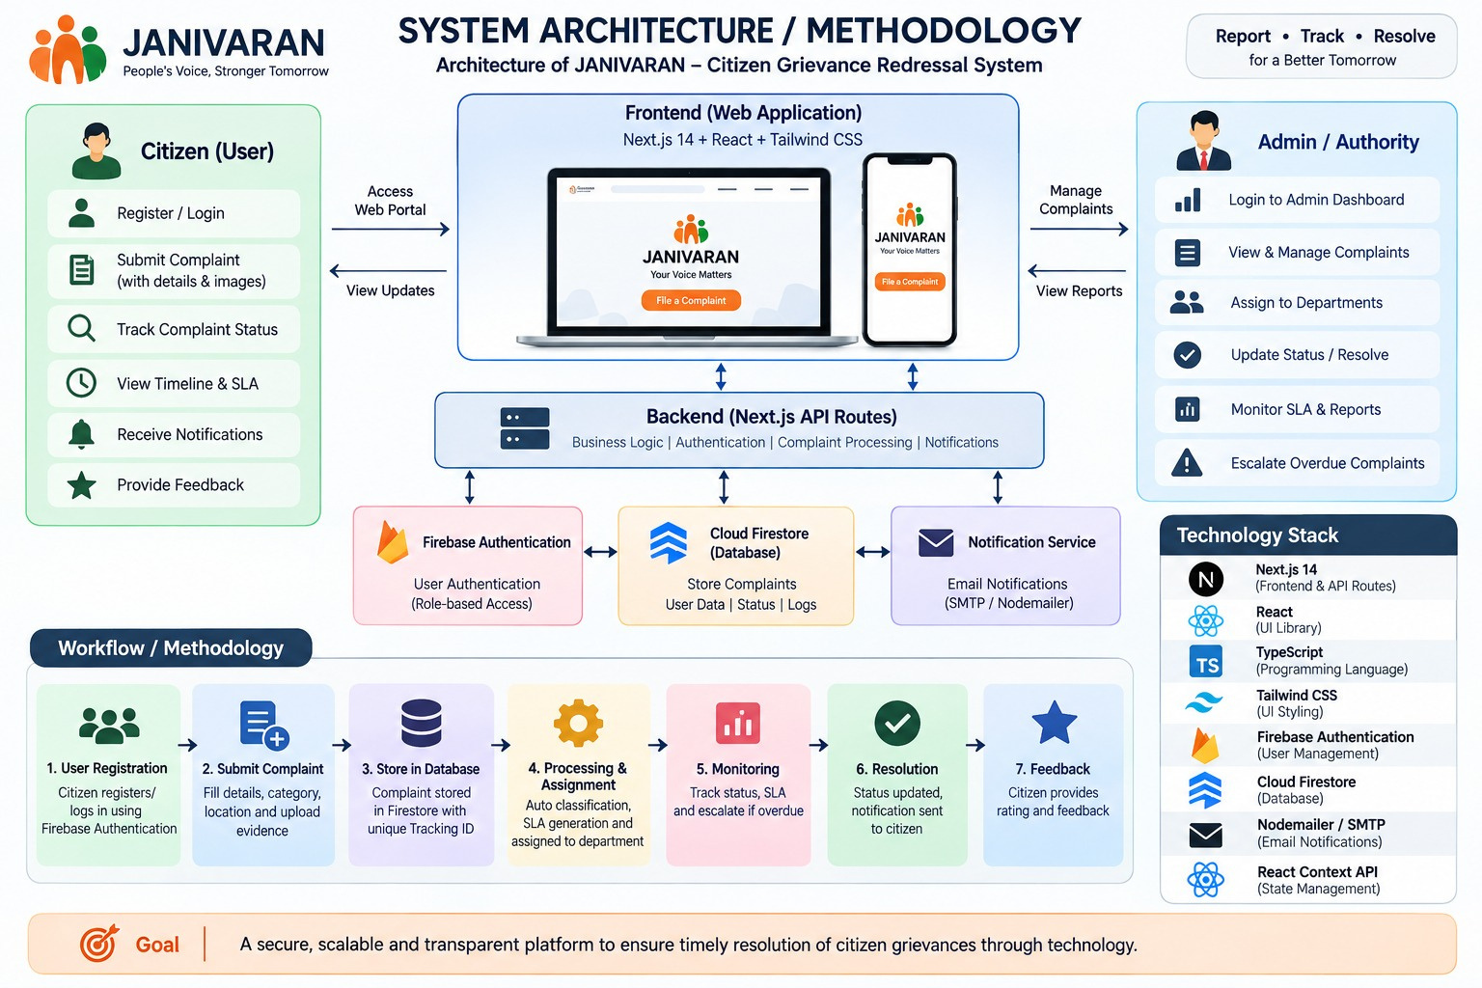

6

Slide 7
IMPLEMENTATION
Software Technologies Next.js 14
React
Tailwind CSS
Firebase Authentication Google Firestore Firebase Admin SDK
PROTOTYPE / SYSTEM IMAGE
MajorImplementedModules
Citizen registration/login Complaint submission
Photo evidence upload Complaint tracking dashboard Status timeline

Slide 8
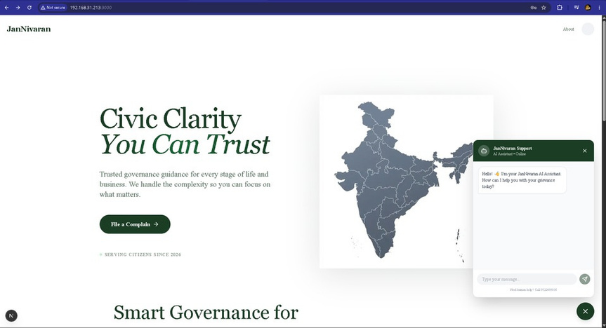
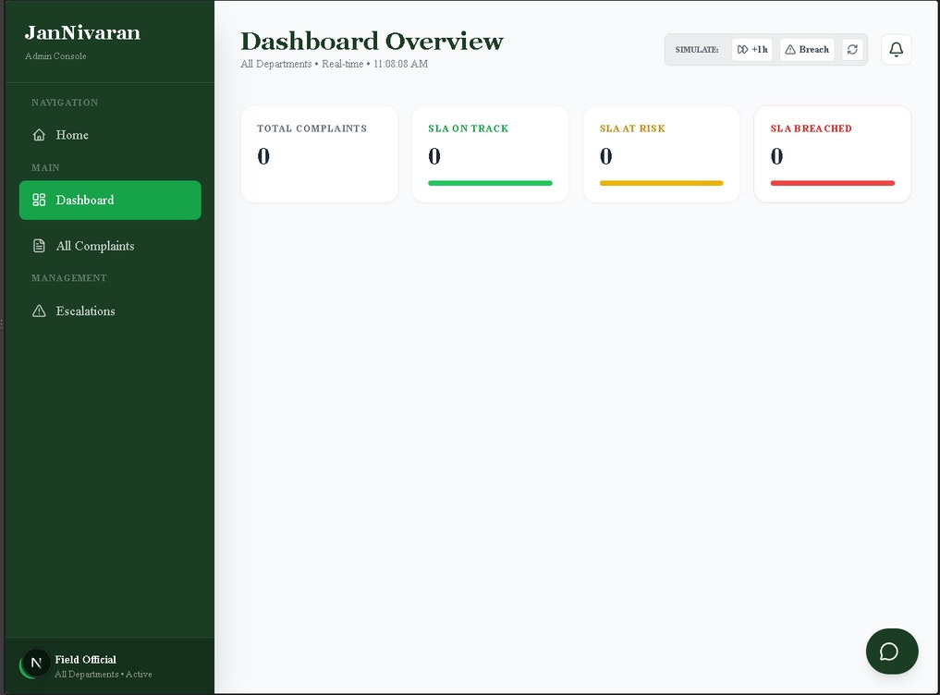
RESULTS / PROTOTYPE
SCREENSHOTS
Client User Base With AI Chatbot
✓
Admin User page

Slide 9
9
INNOVATION, IMPACT, DELIVERABLES & FUTURE SCOPE
Innovation
★
Combinescomplaint management + SLA monitoring + escalation + notifications Visual complaint lifecycle
AI-based citizen support
Impact
Grea↗ter complaint visibility
Better monitoring of delayed cases Reduced dependence on manual follow-up
Deliverables
ComUplaint tracking system
Notification mechanism
AI support module
Future Scope
Mobile application
Multilingual / regional-language support Predictive prioritization of complaints SMS / WhatsApp notifications

Slide 10
CONCLUSION & REFERENCES
Conclusion
JANIVARANprovides a centralized digital platform for citizen grievance registration, tracking, monitoring, and resolution.
Key Takeaways
Simplifies complaint registration
Provides transparent real-time status tracking Supports role-based administrative processing Enables automated notifications and escalation
Reference :
Government grievance-redressal systems
1. CPGRAMS — Centralized Public Grievance Redress and Monitoring System
1.Research paper
Title: Adoption of Online Public Grievance Redressal System in India: Toward Developing a Unified View
Authors: Nripendra P. Rana, Yogesh K. Dwivedi, Michael D. Williams, Vishanth Weerakkody
Journal: Computers in Human Behavior, Volume 59, 2016, pp. 265–282
DOI: 10.1016/j.chb.2016.02.019
https://www.sciencedirect.com/science/article/pii/S0747563216300711?utm

